Slide 1


Automated Bank Complaints
Monitoring
sinoF5 Unstructured data

Slide 2
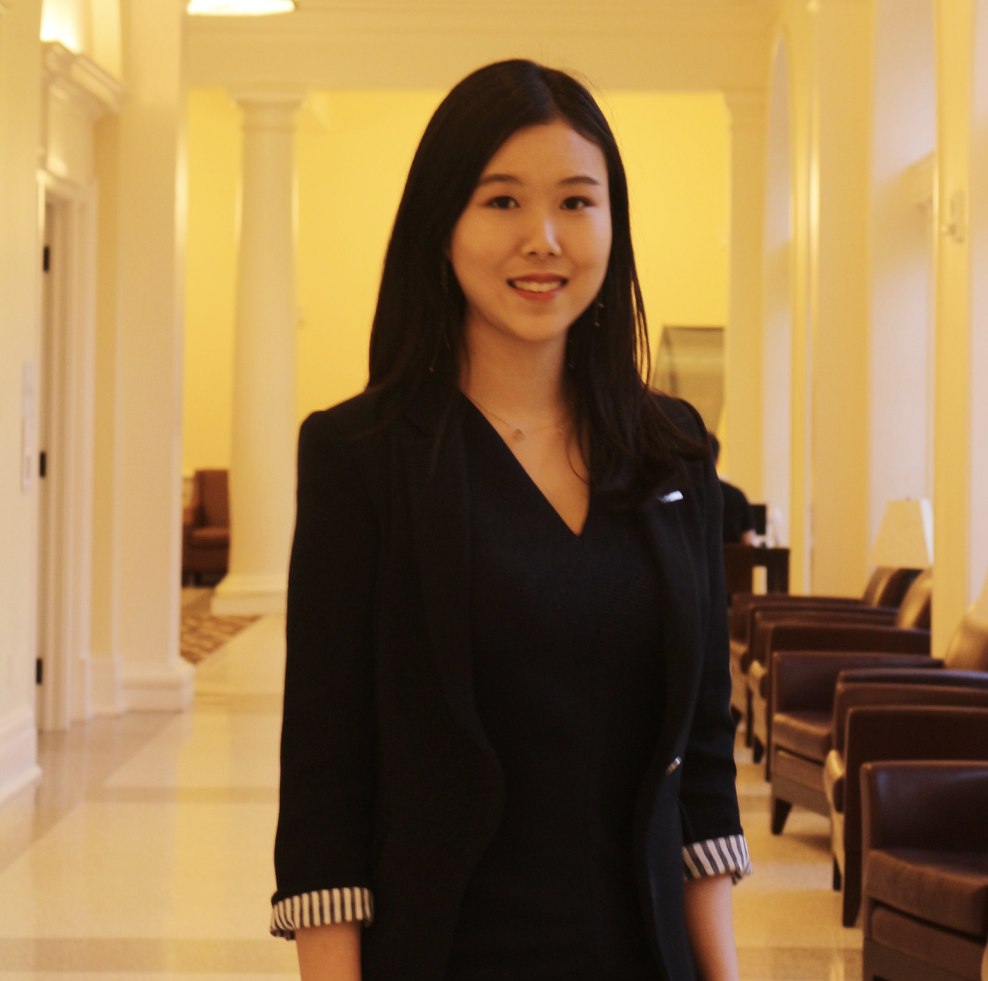

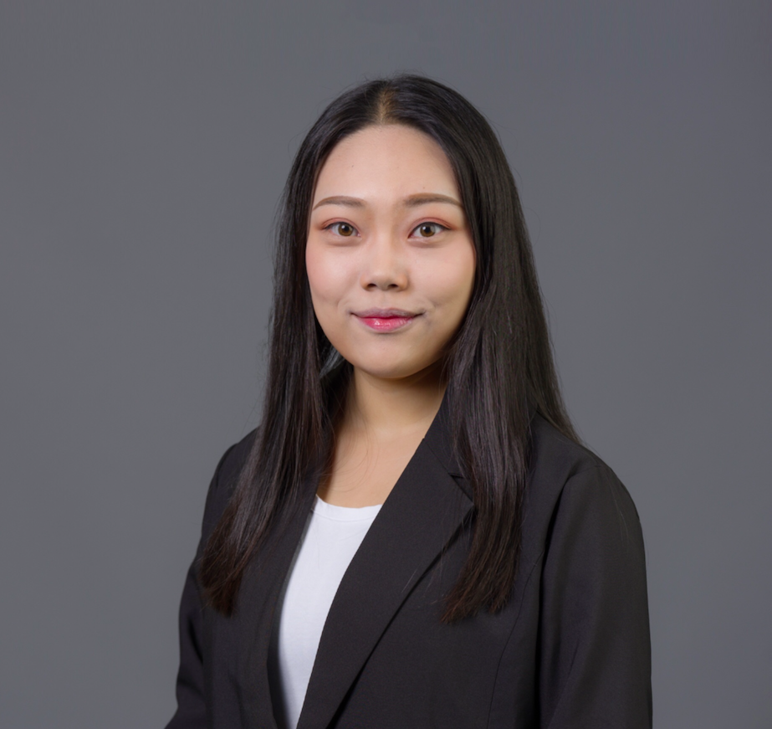

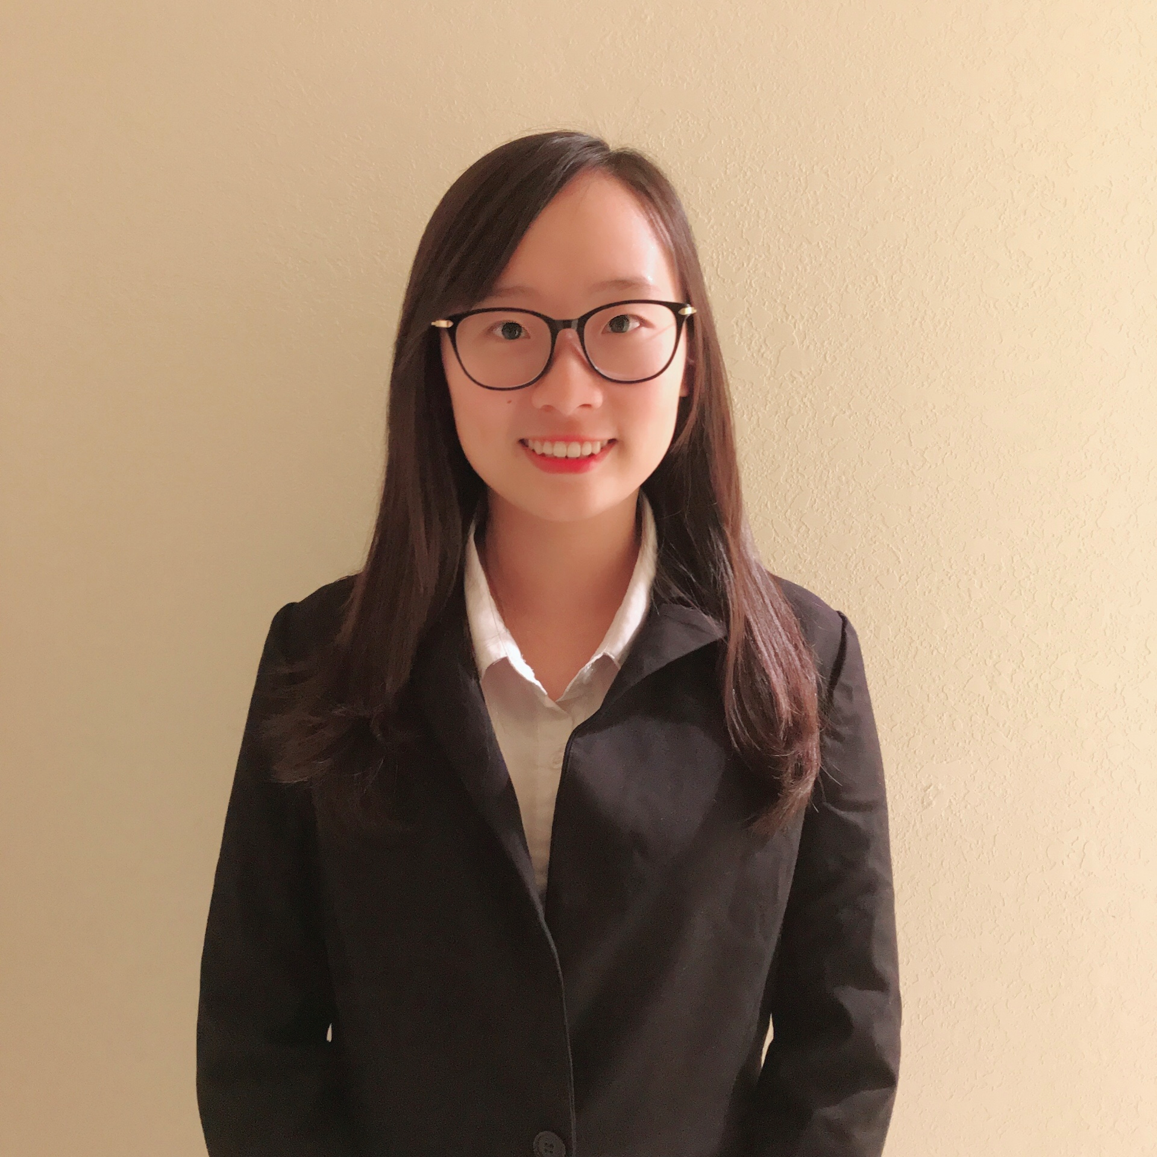

UNITED BANK OF RADY
Customer Service Dep.
Data Science Dep.
2015
Aki Lu
Catherine Liu
Ellen Wu
Letty Hua
Esther Yan

Slide 3


What are customers
complaining about?

Slide 4
Data Description
Total Data | 22984
Monetary Compensated Entries | 5027 (20%)
Non-Monetary Compensated Entries | 17957 (80%)

Slide 5
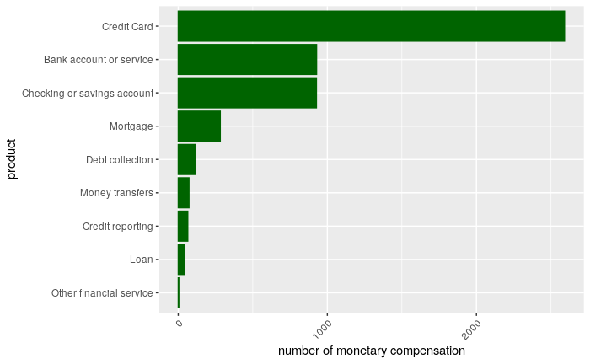
What are the products receiving most monetary compensation?
Most complaints that we give monetary compensation are about
credit card

Slide 6
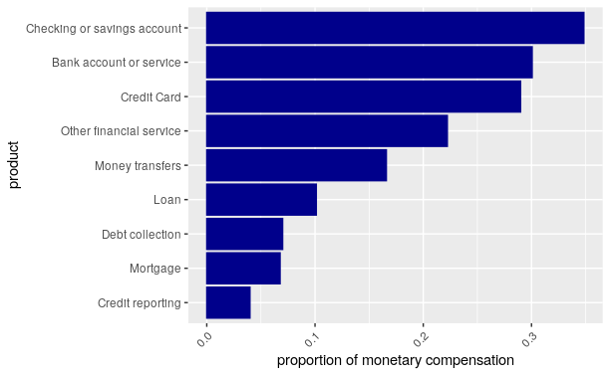
What are the products that have the highest monetary compensation percentage?
checking and bank account
credit card

Slide 7
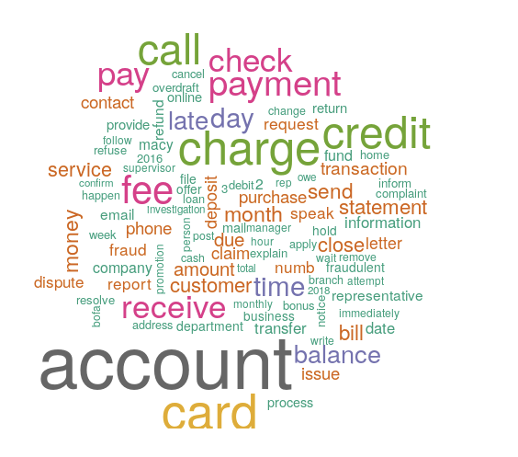
What are the outstanding problems within the complaints that receive monetary compensation?

Slide 8
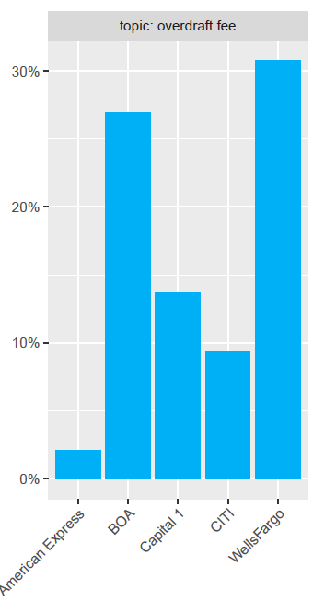
Subsidiary Companies’ problems (Topic Model)
Complaints Topic | Problematic bank
Credit Card Late Fee | Capital One
Debit Card & Fraud | American Express
Deposit Service Fee & Promotion | CITI
Overdraft Fee | Wells Fargo
Social Security & Credit Deposit | American Express

Slide 9
Project Goal
Help find the complaints that would need monetary compensation.

Slide 10
Meeting:
Discuss Approach

Slide 11
One Week Later

Slide 12




Deep Learning Model with One-hot Encoding
Deep Learning Model with Additional Features
Deep Learning Model with Embeddings

Slide 13
APPROACH
Input variable: One-hot encoded
Output variable: Probability
Metrics: AUC
Unbalanced data (80:20)
Complaints: Original VS cleaned
Top frequent words: 8,000

Slide 14
RESULT
Credit Card
Bank Account
# hidden layers: 3
# nodes: 256
AUC on test set: 0.785
# hidden layers: 3
# nodes: 256
AUC on test set: 0.763

Slide 15

MODEL 2:
Deep Learning Model with One-hot Encoding and Additional Features

Slide 16
APPROACH
Based on Model 1, add another feature: length of complaints

Slide 17
RESULT
Credit Card
Bank Account
# hidden layers: 3
# nodes: 256
AUC on test set: 0.787
# hidden layers: 3
# nodes: 256
AUC on test set: 0.770

Slide 18
MODEL 3:
Deep Learning Model with Embeddings

Slide 19
APPROACH
Unbalanced (80:20)
# top frequent words: 8,000
# maximum length of each complaint: 500
Length of each vector: 150
Training: 70%
Test: 30%

Slide 20
RESULT
Credit Card
Bank Account
# hidden layers: 5
# nodes in each hidden layer: 8
AUC on test set: 0.779
# hidden layers: 2
# nodes in each hidden layer: 16
AUC on test set: 0.757

Slide 21
COMPARISON
Model | One-hot | Additional Features | Embeddings
Size | 1.5 GB | 1.5 GB | 46.7 MB
Credit Card AUC | 0.785 | 0.787 | 0.779
Bank Account AUC | 0.763 | 0.770 | 0.757

Slide 22
Specific prediction

Slide 23

I filed a complaint charging my credit card a {$50.00} " restocking fee '' for a phone that I bought and returned to the same store because it didn't work as promised. I got another bill advising me that they plan to auto bill my Barclay card for {$25.00} . I called Barclay today and disputed this new charge. The case number is XX. I have emailed disputing both the {$50.00} " restocking fee '' and this new {$25.00} mystery charge. I DO NOT have a XX account, a phone, and I DID NOT authorize this mystery fee of {$25.00} or any other charges since the day I returned phone and closed my account, and ended forever my no-contract cell service with.
Credit Card:
Unauthorized Charge
✔
Predicted probability: 0.7212
-> Important complaint
On XXXX/XXXX/16 my credit report showed that there were a Capital One and a bank hard inquiries. I called both banks and they both reported not to have any information on the matter. On XX reported again that Capital One had another hard inquiry for trying to open an account. I called capital one and they reported that as a matter of fact someone tried to open an account with Capital One. The representative said she closed the account that was opened on my behalf and report it as fraudulent.
Bank Account:
Fraud
-> Important complaint
✔
Predicted probability: 0.6197

Slide 24
Business Application
(deal from the highest probability)

Slide 25
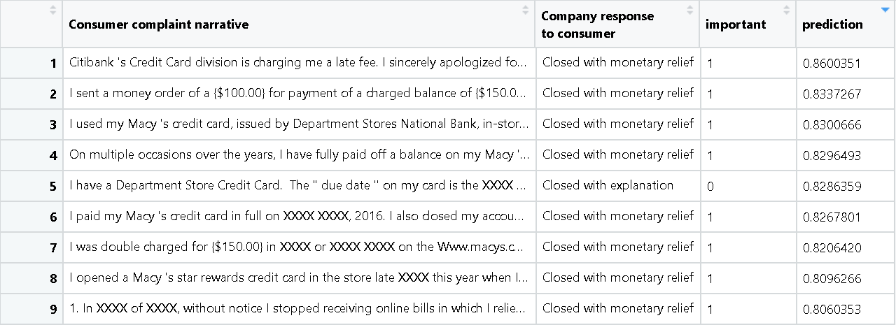
Credit Card

Slide 26
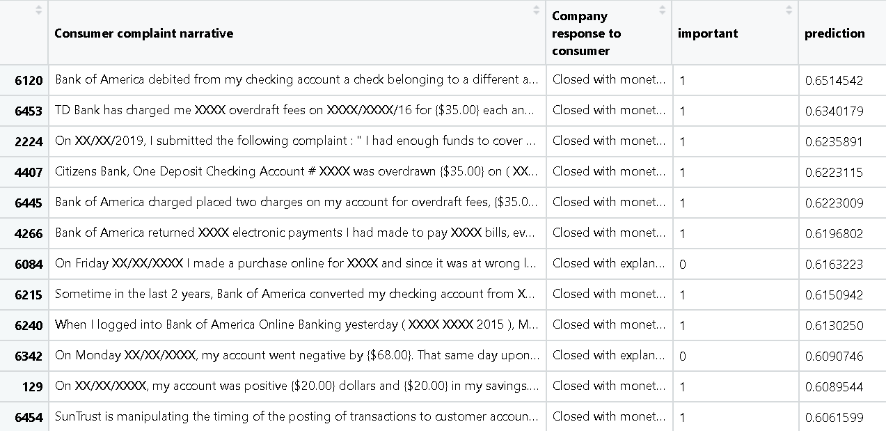
Bank Account

Slide 27
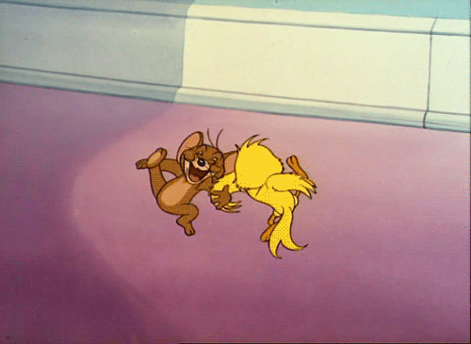

Slide 28
Thank you

